Slide 1

If everyone has HFpEF, does anyone?
B Locke PGR
Notes:
https://www.acc.org/Latest-in-Cardiology/ten-points-to-remember/2023/04/17/16/40/2023-acc-expert-consensus-on-hfpef?utm_source=journalscan&utm_medium=email_newsletter&utm_campaign=journalscan#.ZEp6TIvQ27c.twitter reference / statement that discusses some of these issues that came out after from ACC/AHA

Slide 2
Patient:
65M with 6 months of dyspnea
BMI 36
Current smoking and prior inhalational drug use
Moderate apical paraseptal emphysema; No obstruction on PFTs
TTE with no diastolic dysfunction, mild LVH, mild left atrial enlargement
No improvement with LABA/LAMA trial
CPET:
VO2 max ~45% weight normalized predicted
VEVCO2 43
Maximum HR 110; Significant metabolic acidosis
Normal MVV; Low BR

Slide 3
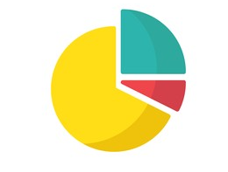
2 arguments why HFpEF at pulmonary GR
Diagnosis of symptomatic disease
👎: Se = (# Patients w/ finding & disease) / (# Patients w/ Finding whether or not they have disease*)
Consider how we do PFTs
*Susceptible to subtle spectrum bias
👍: (Likelihood in COPD) / (Likelihood in HFpEF)
You have a differential. You want findings that discriminate between the options (NOT findings that separate has disease vs doesn’t have disease)
Opinion: 👎 “Reason for Consult: Dyspnea; ….
A/P: Not the lungs”
If a reason for dyspnea is needed and possible, we should be able to diagnose it regardless where in the chain of respiration the problem occurs.
Our expertise is the entire respiratory system
Consider Nephrology: Recs re AKI diagnosis
COPD
HFpEF
PAH
Notes:
Ya that GFR is low, but we think it’s a prerenal problem so not interested.
Symptoms are no obligation to respect the divisions between specialties we’ve come up with.

Slide 4
Aims
Review diagnostic criteria for HFpEF
Review notable (or not) findings in HFpEF
What’s up with chronotropic incompetence?
What’s up with the wedge?
What’s up with the pleural pressure?

Slide 5
True or False: CPET is gold standard for diagnosing HFpEF?
True
False

Slide 6
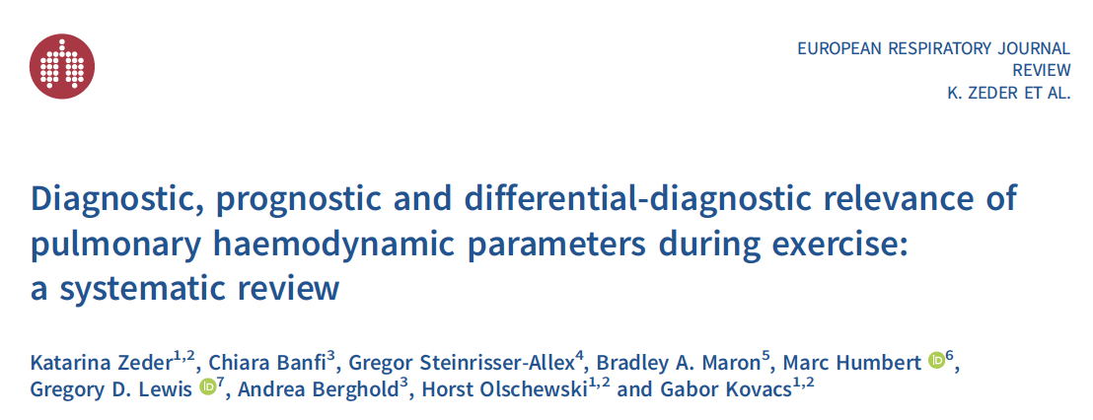
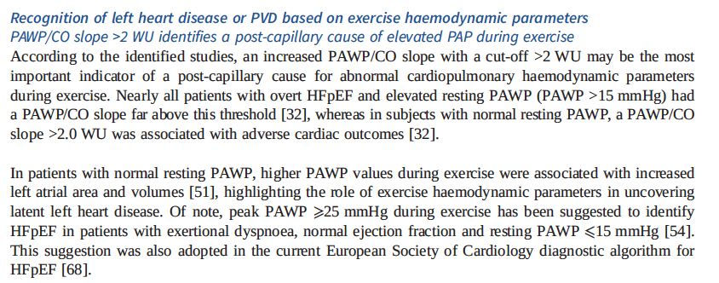
True or False: CPET is gold standard for diagnosing HFpEF?
True
False
The [ exercise ] RHC directly measures atrial pressures and is considered the criterion standard (100% sensitivity and specificity; C statistic, 1.0) for HFpEF diagnosis*
We will discuss this more.

Slide 7
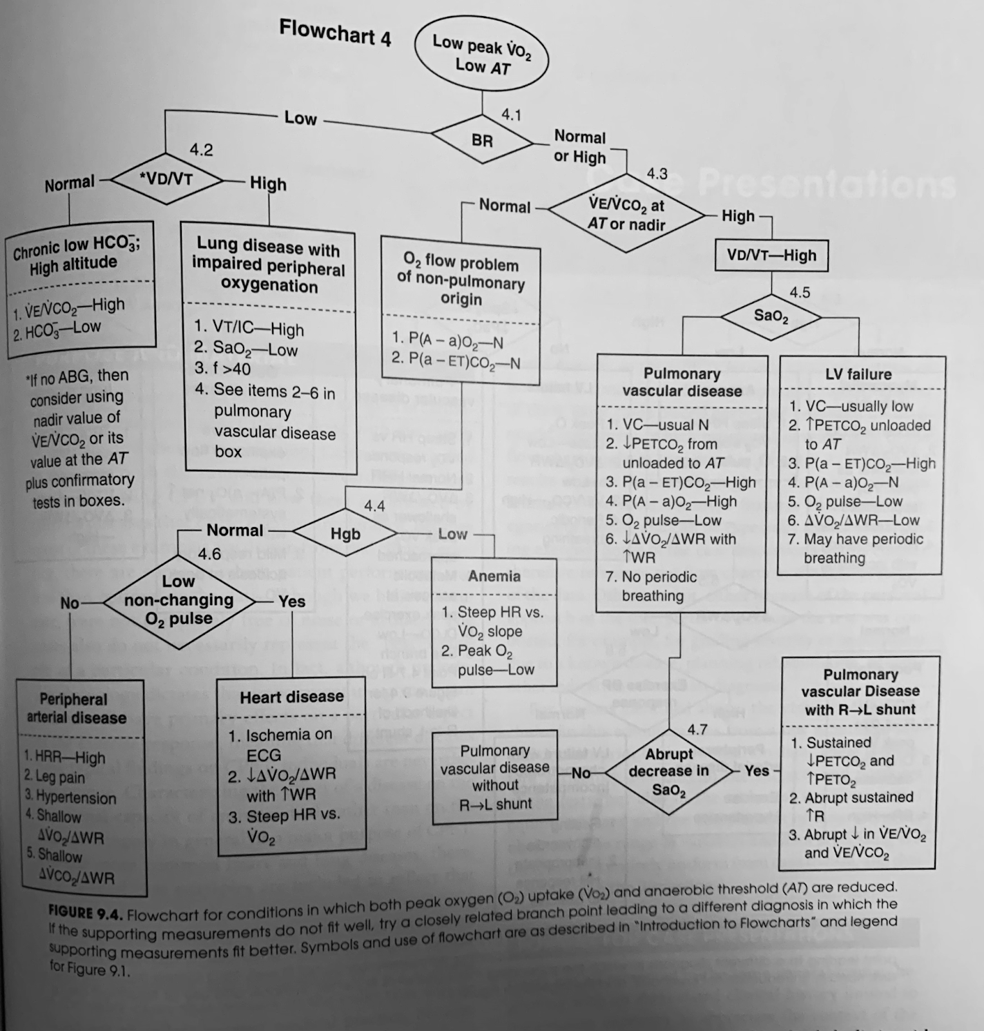
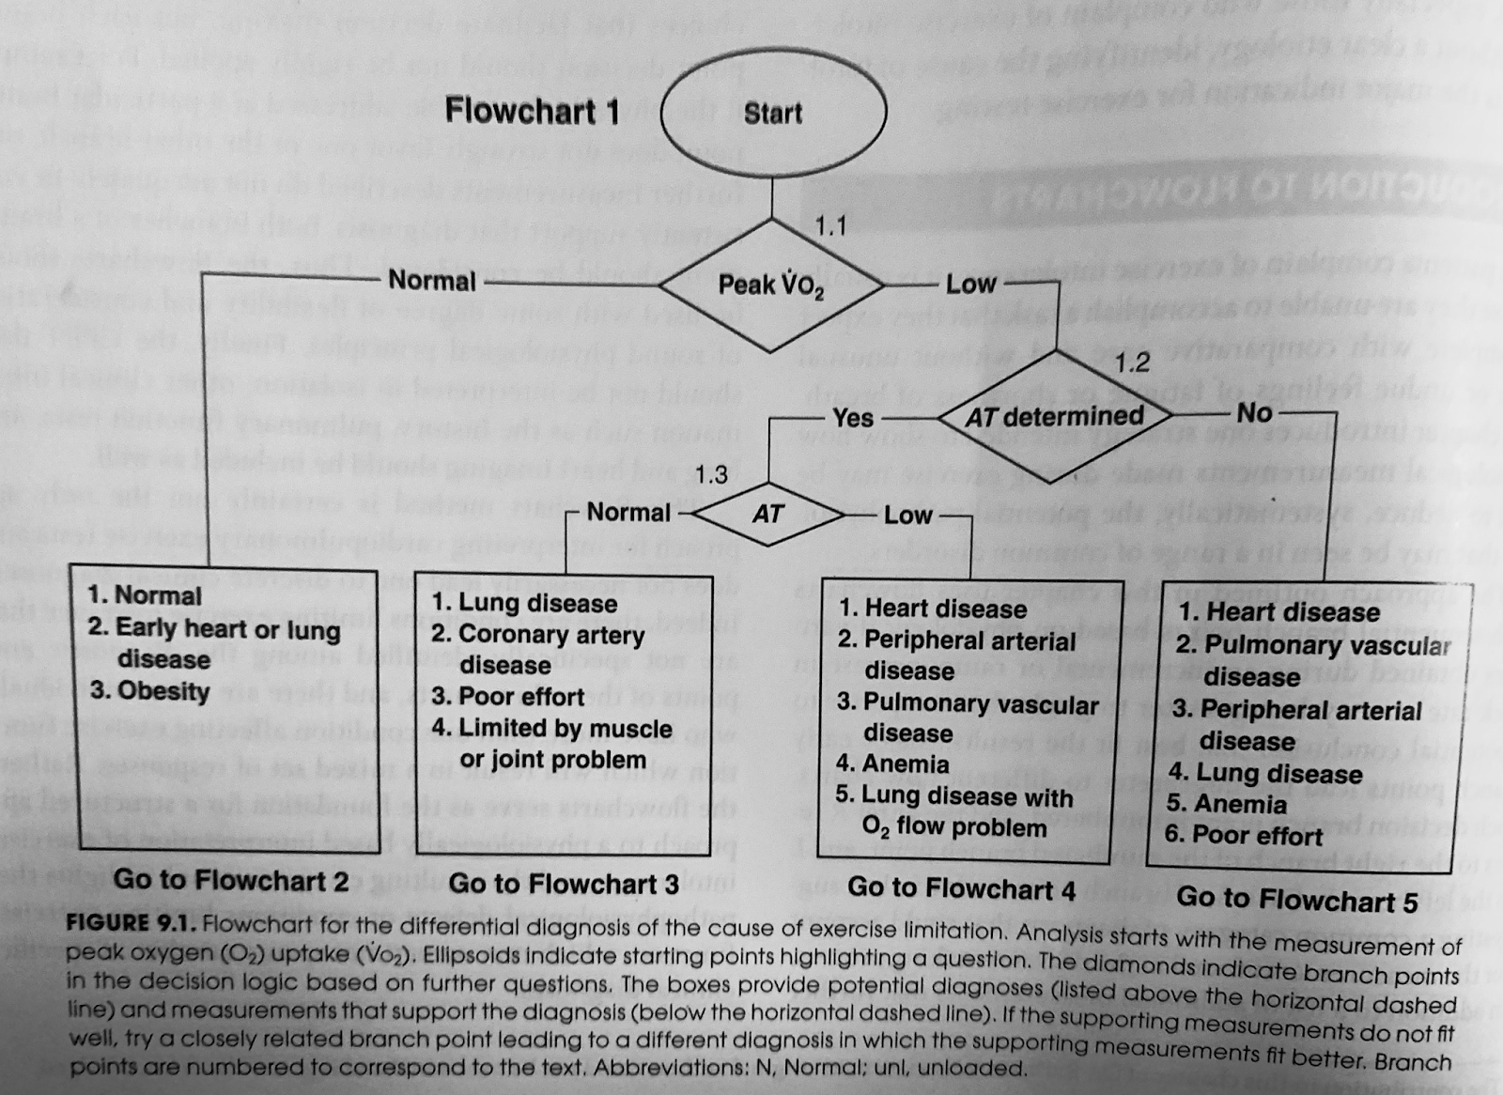
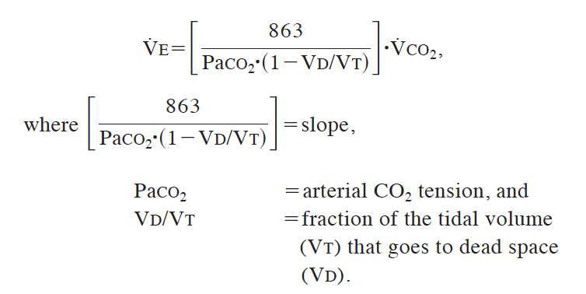
CPET in CHF

Slide 8
Abnormalities on TTE are required to diagnose HFpEF?
True
False

Slide 9
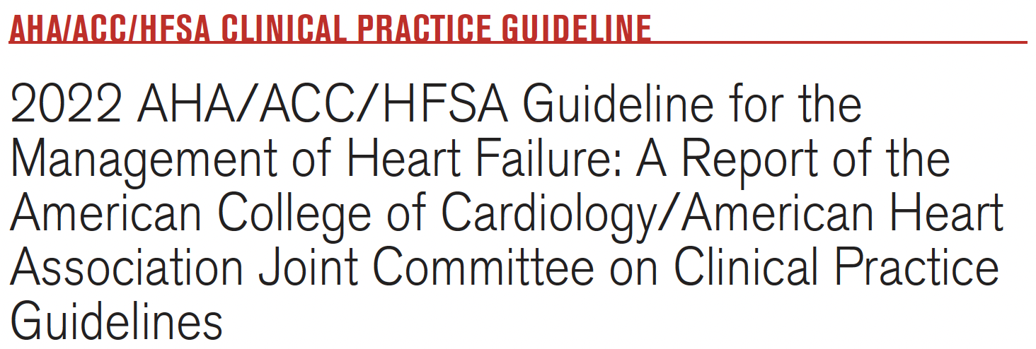
Abnormalities on TTE are required to diagnose HFpEF?
True
False
Requires evidence of increased filling pressures (R atrial pressure, PCWP, or LVEDP) at rest or with exercise. Which can be:
TTE
Catheterization
Or inferred by physical exam/CXR/BNP*/H2FPEF score
30% of patients with elevated PCWP have BNP < 100. (“BNP/NT-proBNP assays are insufficient to rule out HFpEF, particularly in younger patients, those with sinus rhythm, and those with obesity and/or normal kidney function.”)

Slide 10
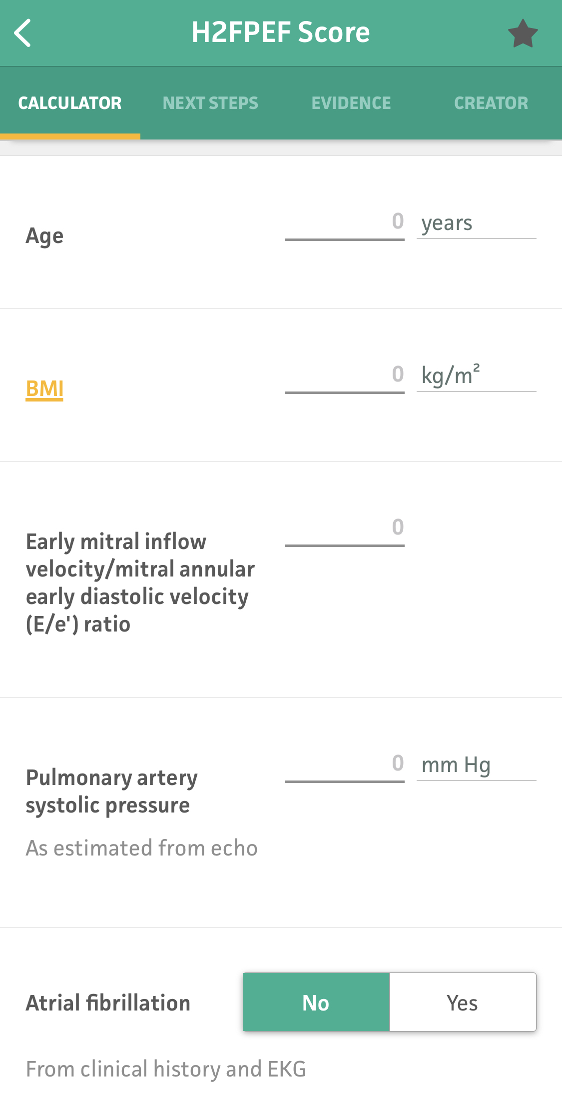
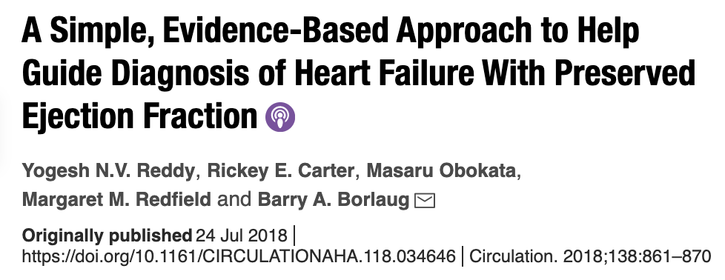
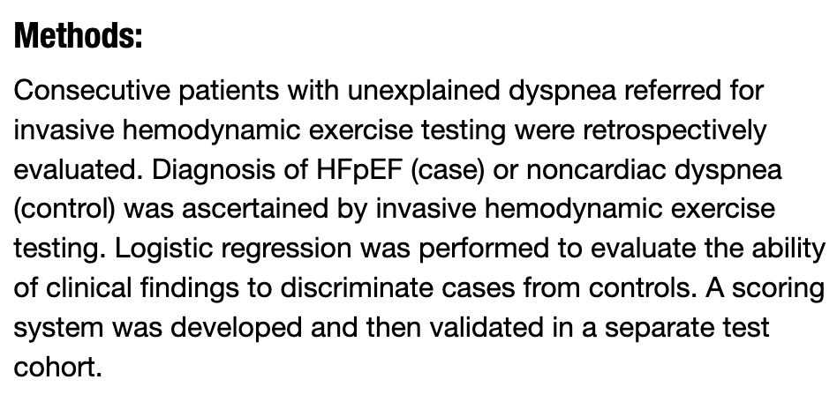
HF2PEF (2022 ACC/AHA CPG)
Rest PCWP 15+ OR Exercise PCWP 25+
60% had HFpEF
The odds of HFpEF doubled for each 1-unit score increase
Notes:
in a consecutive series of patients with normal EF and unexplained dyspnea (HFpEF prevalence of 50%-60%),^{44,45} a score of 6 or higher was associated with more than 95% probability of HFpEF, whereas a score of 0 or 1 was associated with less than a 25% probability of HFpEF. Additional testing (rest/exercise RHC or rest/exercise Doppler echocardiography) is required in patients with intermediate (2-5) scores.^{44,45}
60% HFpEF prevalence.
The odds of HFpEF doubled for each 1-unit score increase

Slide 11
You are evaluating a patient you think has HFpEF. They do not have crackles. How does this change the likelihood they have congestion?
A lot more likely
A little more likely
No difference
Less likely
”[Congestion can be] inferred from physical exam”
Notes:
65% Dyspnea and Overt Congestion
35% Dyspnea without Congestion

Slide 12
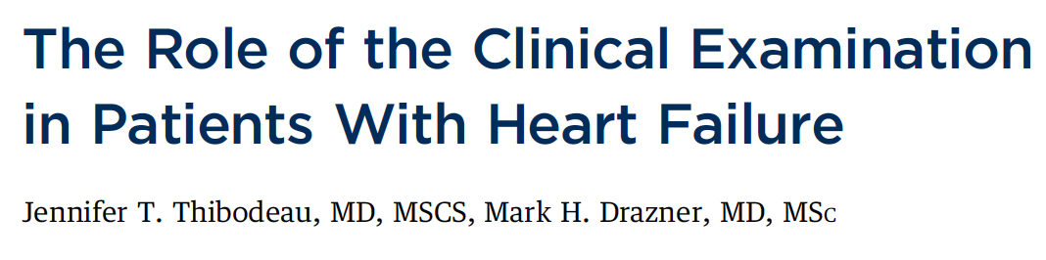
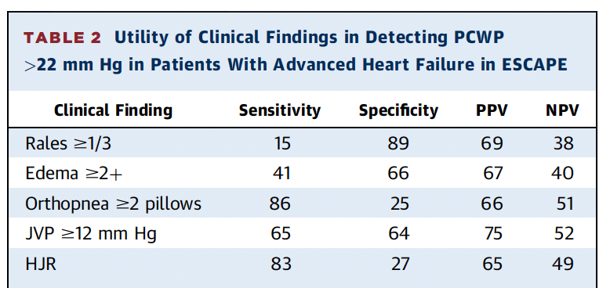
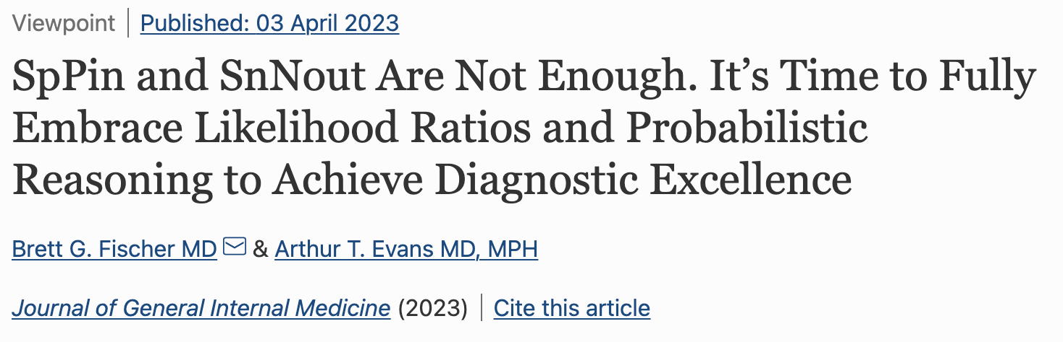
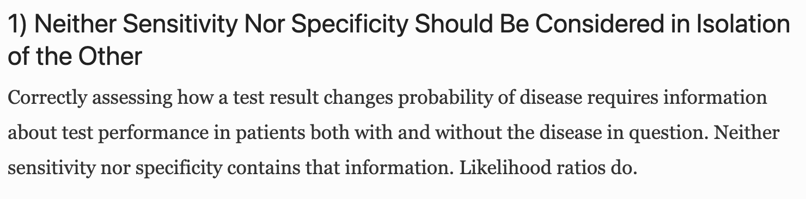
You are evaluating a patient you think has HFpEF. They do not have crackles. How does this change the likelihood they have congestion?
A lot more likely
A little more likely
No difference
Less likely
ESCAPE Trial: RCT of PA-C guided CHF mgmt vs clinical exam guided.
Analysis of the 250 randomized to PA-C
Crackles (1/3 of lung field): +LR 1.36, -LR 0.96 for predicting PCWP 22+ mmHg
Most patients do not have crackles related to chronic, congested HF. Presence/absence of crackles barely gives any information about congestion.
Se + Sp = 100% => adds no information
Notes:
“Wet”, PCWP >15mmHg
“Dry”, PCWP <15mmHg
Bendopnia: filling pressure increase with bending over – occurs in 3—50%
https://www.jacc.org/doi/10.1016/j.jchf.2018.04.005
https://www.cardionerds.com/142-the-role-of-the-clinical-examination-in-patients-with-heart-failure-with-dr-mark-drazner/

Slide 13
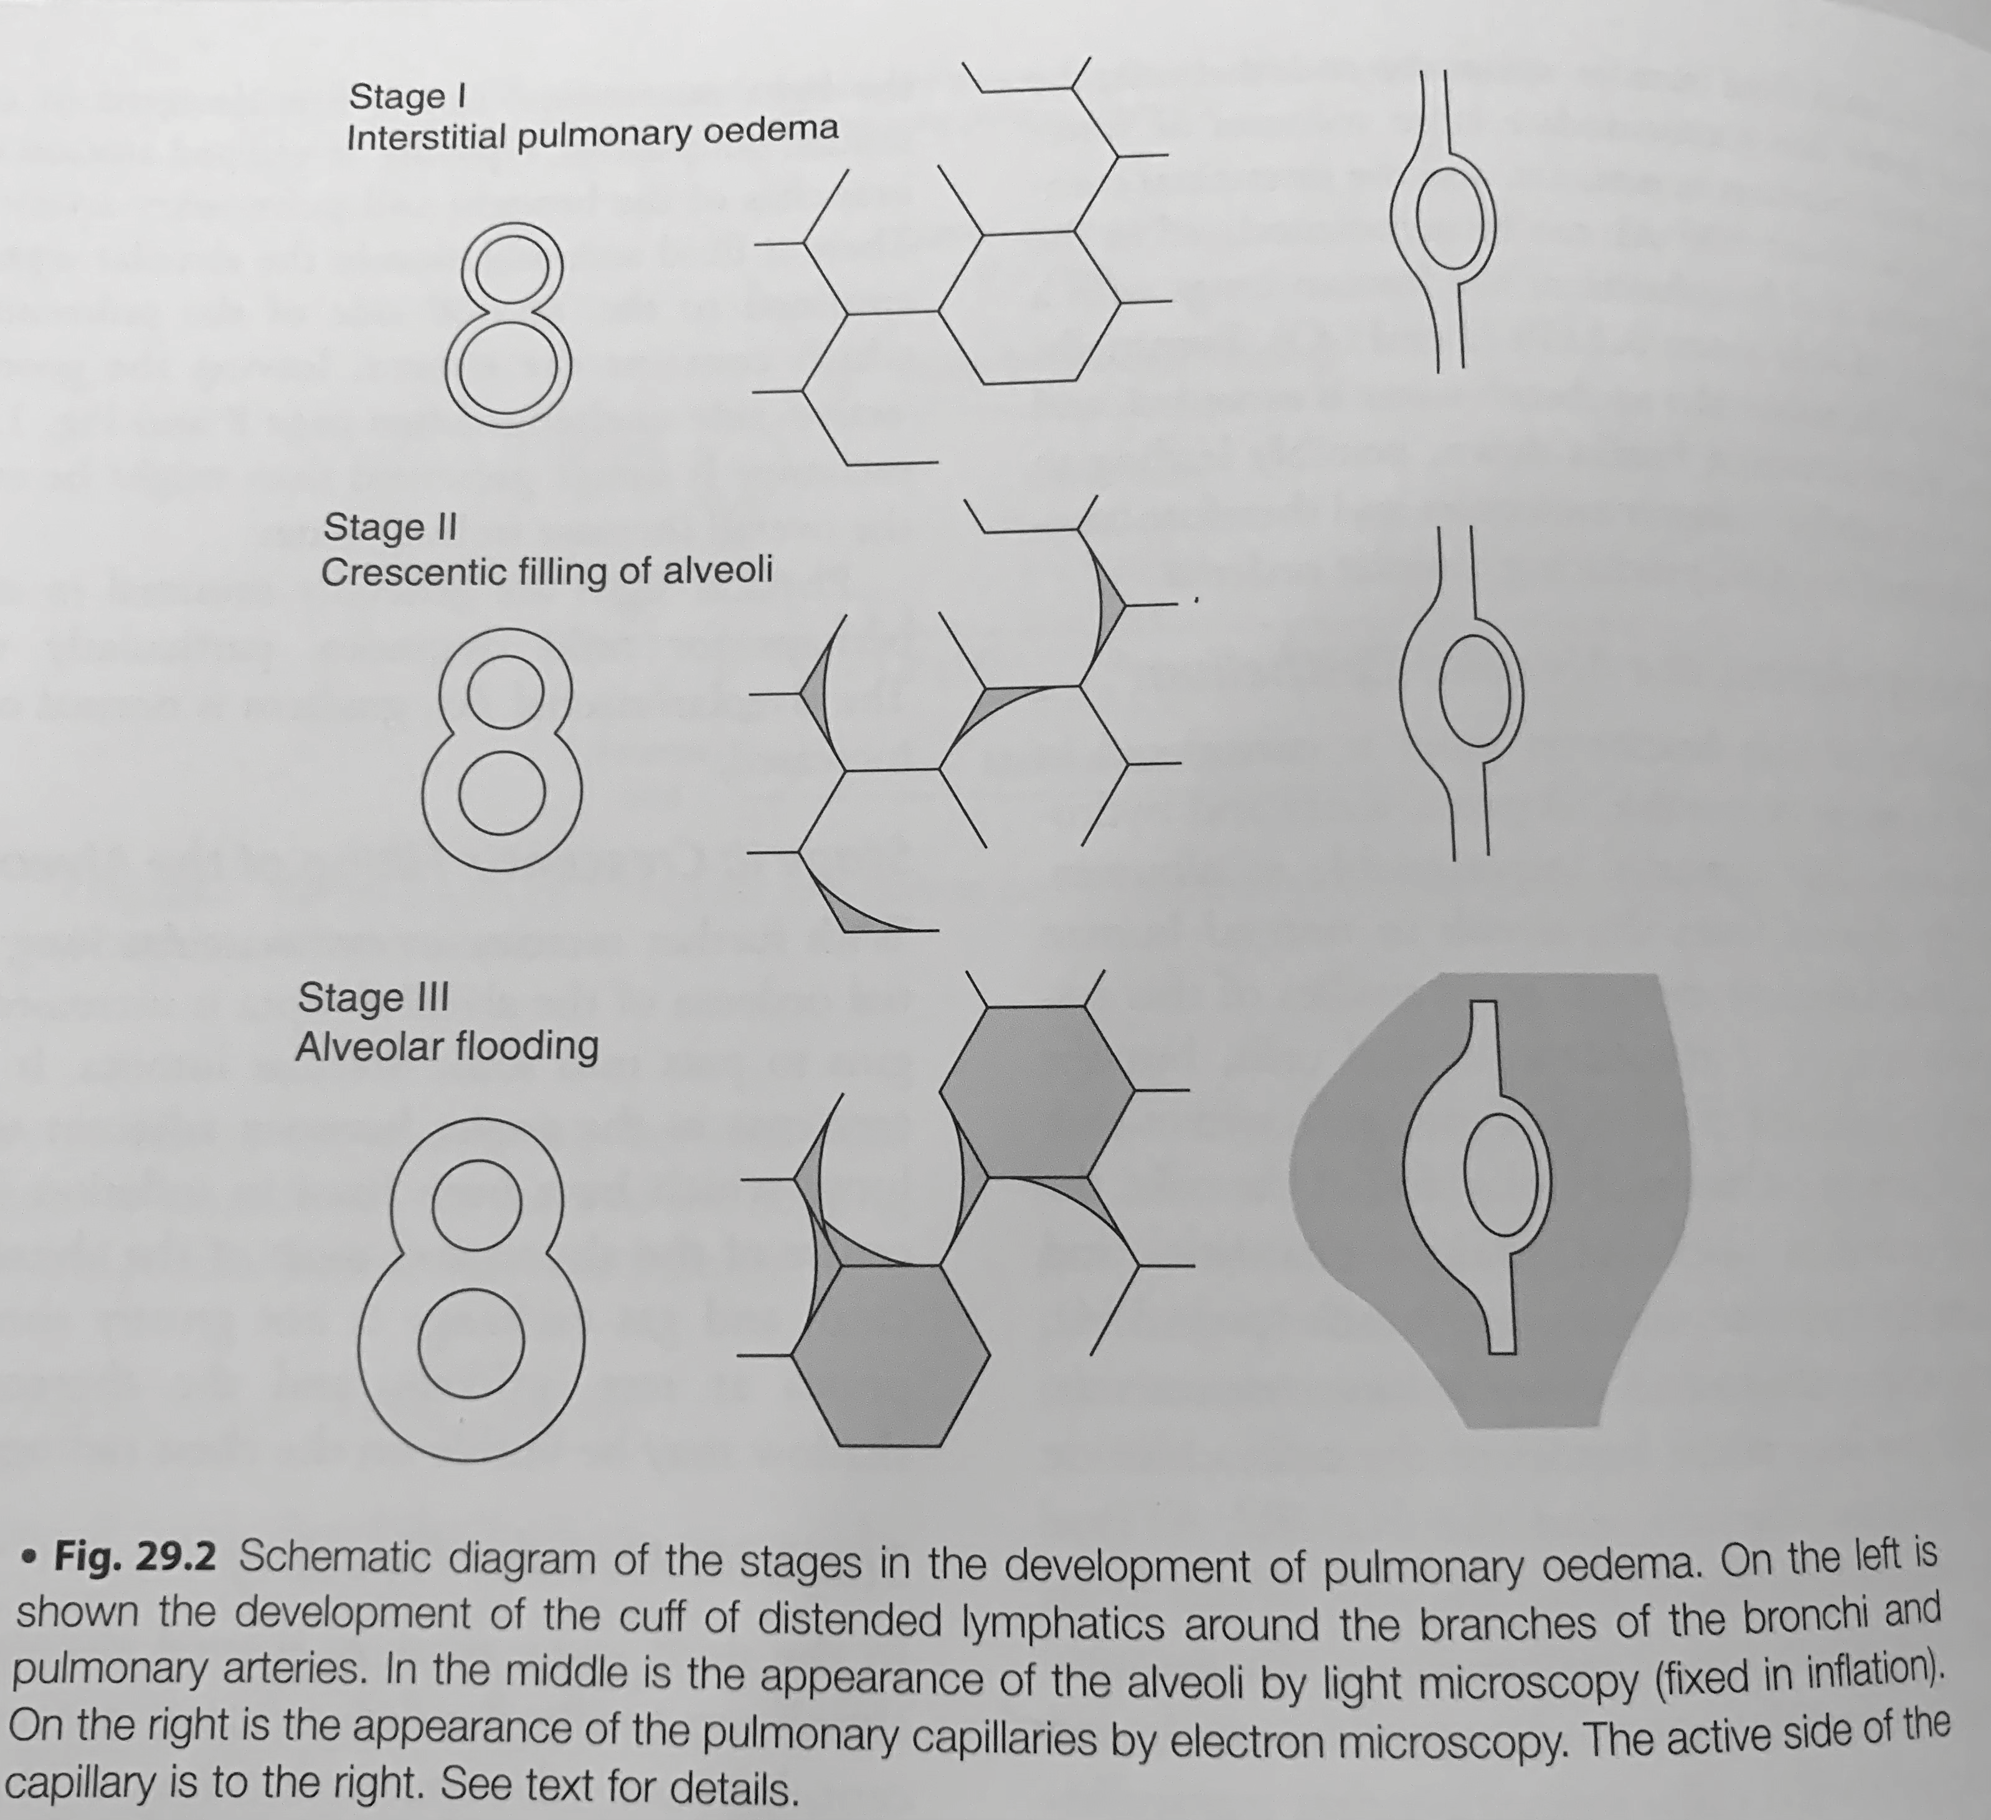
Why?
Stage 1: interstitial fluid (can be up to 500mL with minimal extra pressure). No crackles.
Stage 2 Crescentic filling of the alveoli
Stage 3 Alveolar Flooding. Crackles
Stage 4 Froth in air passages
Notes:
Patients with chronic congestive heart failure only get alveolar edema in severe states of fluid overload. More than 500mL of fluid is absorbed in the interstitial space (=lack of usefulness of crackles), and clearance w chronicity. https://ejropen.com/article/S2352-0477(20)30063-0/fulltext…
https://pubmed.ncbi.nlm.nih.gov/6845168/
Colloids do not help with noncardiogenic pulmonary edema.
Cardiogenic pulmonary edema?
Starling equation
Bronch study?proteinaceous BAL, HAPE
=➔ evidence on albumin and cardiogenic pulmonary edema.
Diffuse alveolar damage - https://www.atsjournals.org/doi/full/10.1164/rccm.202008-3149IM
Patients with established chronic heart failure
(CHF) often display increased pulmonary venous
pressure,18 but the correlation with lung congestion
is surprisingly weak and some patients can
tolerate even marked elevations of left atrial
pressure without developing signs of lung con
gestion. This could be explained by chronic
19, 20
adaptation to increased pulmonary venous pressure
with basal membrane thickening, reduced capillary filtration,
and increased lymphatic 21, 22 drainage
.23
18. Staub NC. Pulmonary edema. Physiol Rev 1974;54:678– 811.
19. Mahdyoon H, Klein R, Eyler W, Lakier JB, Chakko SC, Gheorghiade M. Radiographic pulmonary congestion in end-stage congestive heart failure. Am J Cardiol 1989;63:625–7.
20. Chakko S, Woska D, Martinez H, de Marchena E, Futterman L, Kessler KM, et al. Clinical, radiographic, and hemodynamic correlations in chronic congestive heart failure: conflicting results may lead to inappropriate care. Am J Med 1991;90:353–9.
21. Dixon DL, Mayne GC, Griggs KM, De Pasquale CG, Bersten AD. Chronic elevation of pulmonary microvascular pressure in chronic heart failure reduces bi-directional pulmonary fluid flux. Eur J Heart Fail 2013;15:368–75.
22. Townsley MI, Fu Z, Mathieu-Costello O, West JB. Pulmonary microvascular permeability. Responses to high vas
cular pressure after induction of pacing-induced heart failure in dogs. Circ Res 1995;77:317–25.
23. Gheorghiade M, Follath F, Ponikowski P, Barsuk JH, Blair JE, Cleland JG, et al.; European Society of Cardiology; European Society of Intensive Care Medicine. Assessing and grading congestion in acute heart failure: a scientific statement from the acute heart failure committee of the heart failure association of the European Society of Cardiology and endorsed by the European Society of Intensive Care Medicine. Eur J Heart Fail 2010;12:423–33

Slide 14
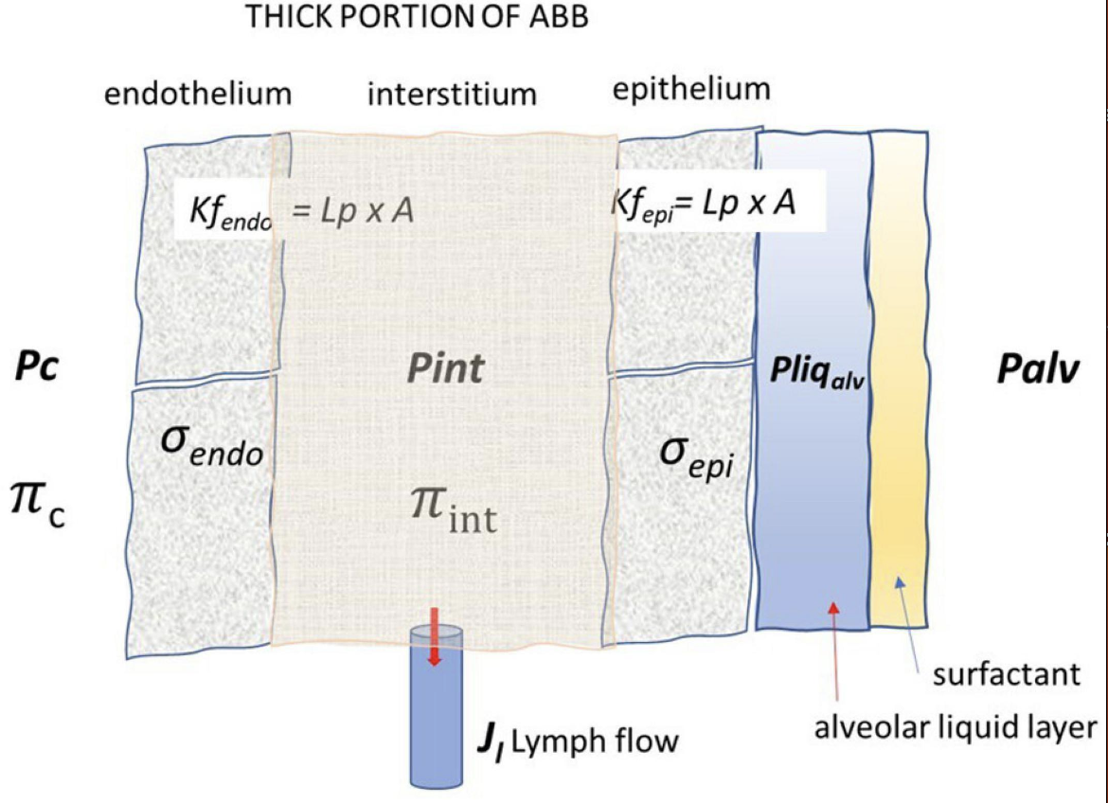
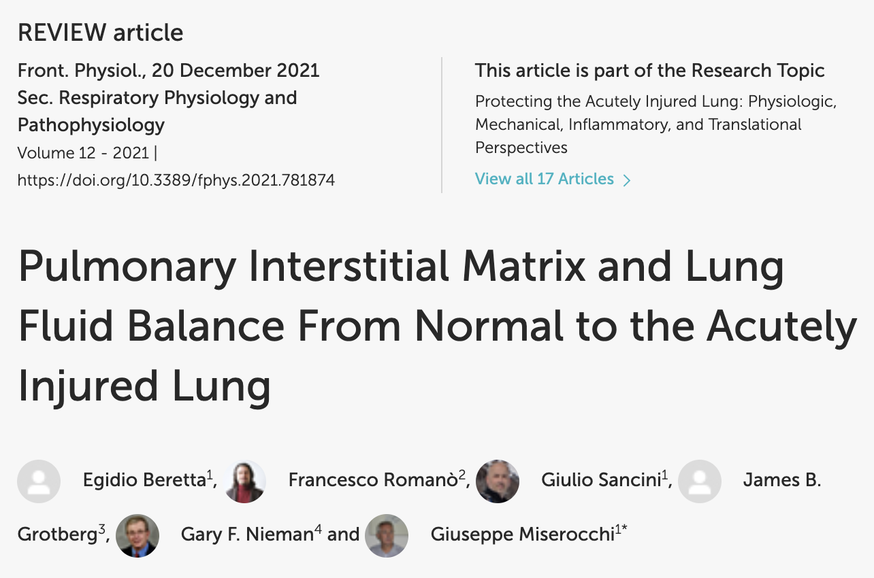
Pulmonary Edema: Interstitial & Alveolar
Inflammation?
Endothelial (vessels-interstitium) Gradient & Permeability: interstitial edema?
Epithelial (interstitium-alveoli) Gradient & Permeability: alveolar edema?

Slide 15
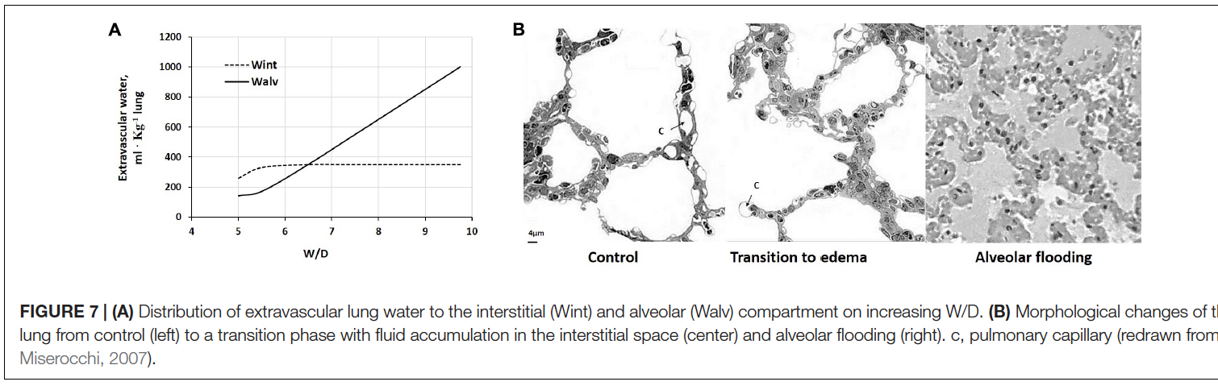
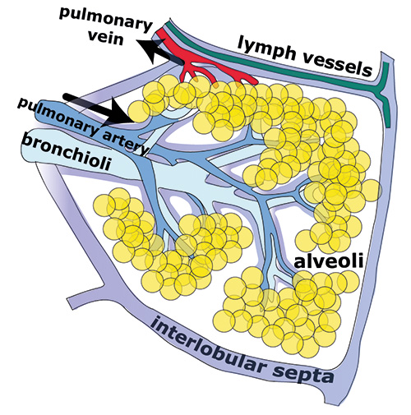
In normal conditions, most fluid returns to the capillaries by starling forces, 18% by lymphatics
In edematous states, lymphatics increase 8-10 fold
Precapillary vasoconstriction -> divert blood flow away from portions of lung with high fluid flux. This has significant inter-individual variation that may contribute to individuals “prone-ness” to edema formation.
Derangements/loss of protective factors can be regional: imaging findings can be “geographic” even when “cardiogenic”
Time constant of alveolar flooding: 3 minutes
Presentation of HF w Alveolar Edema =/= HF w/o Alveolar Edema
Notes:
Very little fluid moves across the air-blood barrier despite large transepithelial starling gradients as long as the interstitial matrix is not damaged.
When does interstitial edema become alveolar edema?
Vessel -> intstitium = transendothelial (PEEP doesn’t help); interstitium -> alveolar = transepithelial (PEEP helps, worsened by lung injury)
Interstitial edema = ~5.5 W/D ratio, Alveolar begins to occur ~6 -6.25.
Alveolar flooding happens fast ~3 minute time constant.
Interstitial fluid flux: subject to starling forces, Wet-to-Dry index summarizes flux. “Safety factor” = formation of interstitial gel.
Usual ’flux’ = Na+ dependent reabsorption
Note: point B can occur due to increased CO (e.g. marathon running) and is well compensated unless the “safety factor” mechanism is lost
Inflammation (whether sterile or non-sterile) leads to loss of this mechanism
Specifically, overdistention, ROS implicated
Citation:
Beretta E, Romanò F, Sancini G,
Grotberg JB, Nieman GF and
Miserocchi G (2021) Pulmonary
Interstitial Matrix and Lung Fluid
Balance From Normal to the Acutely
Injured Lung.
Front. Physiol. 12:781874.
Implication: is the wedge really telling us that much about edema? No – but may be a stratificatiotn of “cardiogenic” vs “non-cardiogenic” aka permability mediated. )
Changes in Starling gradients and permeability parameters
may be combined differently within the whole lung. In fact,
the available experimental evidence confirms the heterogeneity
in both regional lung fluid accumulation and perfusion under
edemagenic conditions (Bachofen et al., 1993). Basal lung regions
are, in general, more exposed to edema because of greater
blood perfusion, implying higher capillary Kf (Rivolta et al.,
2011). Alveolar flooding was found to occur in a quite nonhomogeneous
fashion revealing considerable regional differences
Since the distribution of edema is heterogeneous by nature,
in the lung portions where W/D < 6.5, the control of lung
fluid balance is only possible when the built-in safety factors,
intact matrix, interstitial capacity, and lymphatics not yet
saturated, are still functional.
(Wu et al., 1995).

Slide 16
The mechanism of dyspnea in HFpEF is that PCWP increases with exertion
True
False
Notes:
Inability to increase heart rate with activity (chronotropic incompetence) is common in HFpEF and associated with worse exercise capacity. In a randomized clinical trial, rate-responsive atrial pacing increased early and peak exercise heart rate, but did not improve exercise performance or quality of life
-→ reddy Jama Trial

Slide 17
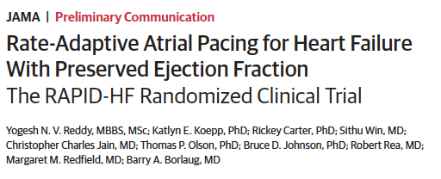
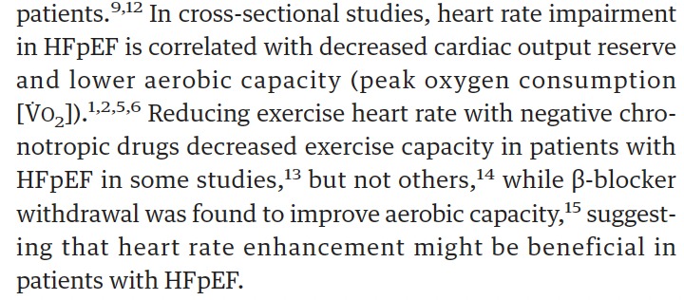
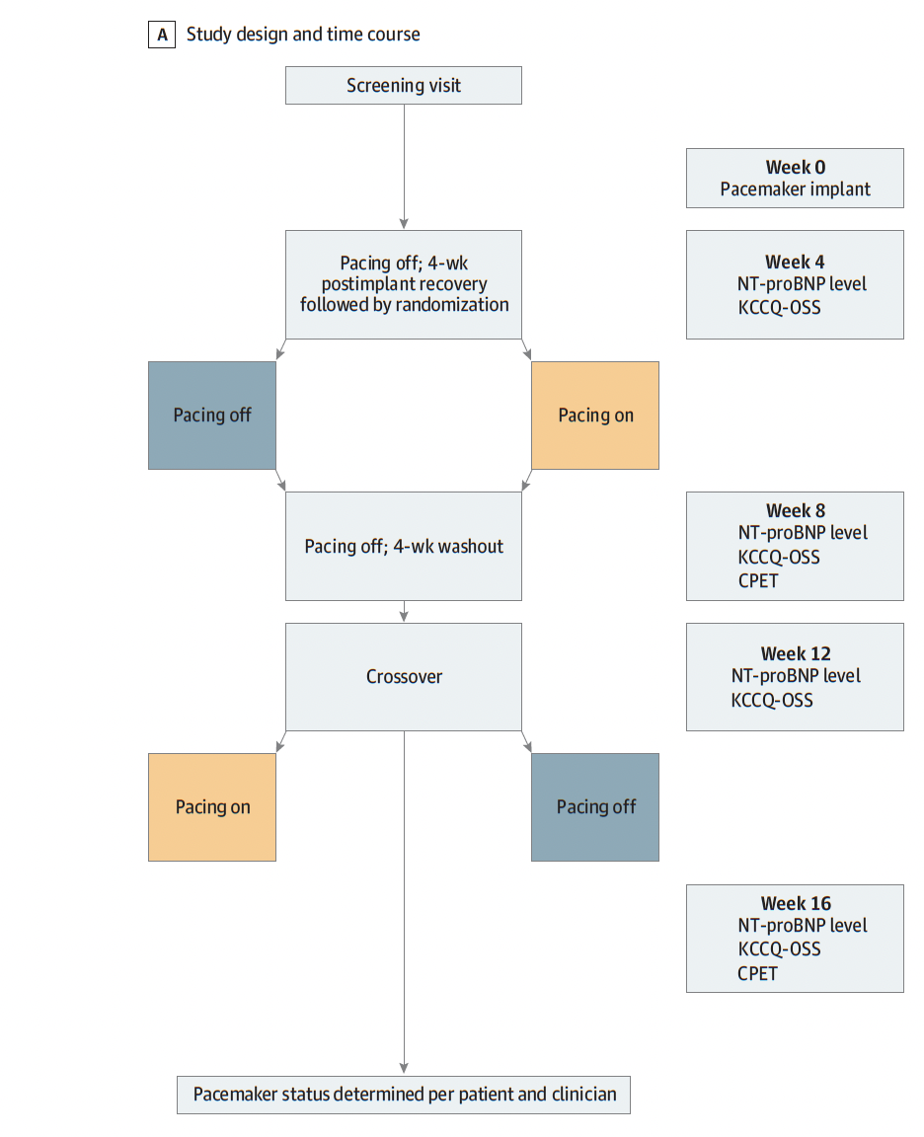
HR response to exercise is reduced in patients with HFpEF
This was generally considered pathologic
Chronotropic incompetence = inability to meet predicted maximum heart rate
Patients with HFpEF and chronotropic incompetence having a PM implanted were randomized to “Fast” vs ”Regular” pacing with exercise.
Notes:
exertional rate-adaptive atrial pacing, with no planned pacing at rest
HFpEF -> often goes along with chronotropic incompetence, and worse chronotropic incompetence = worse dyspnea.

Slide 18
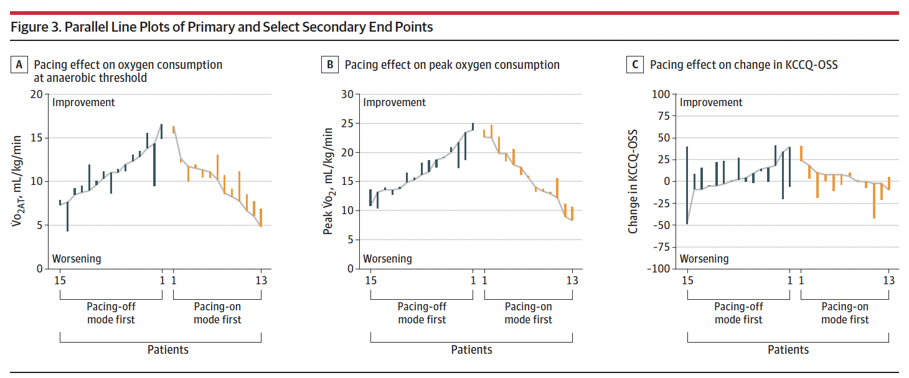
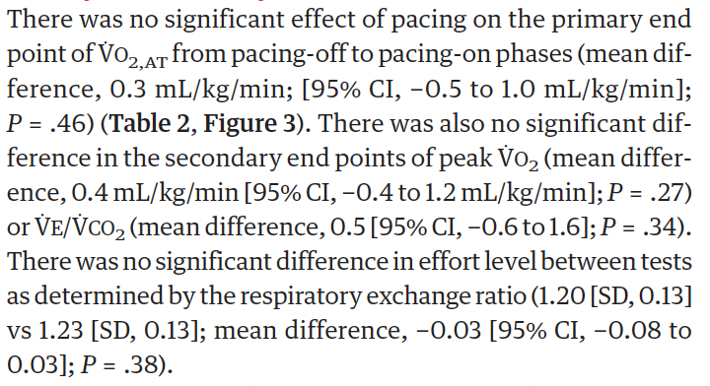
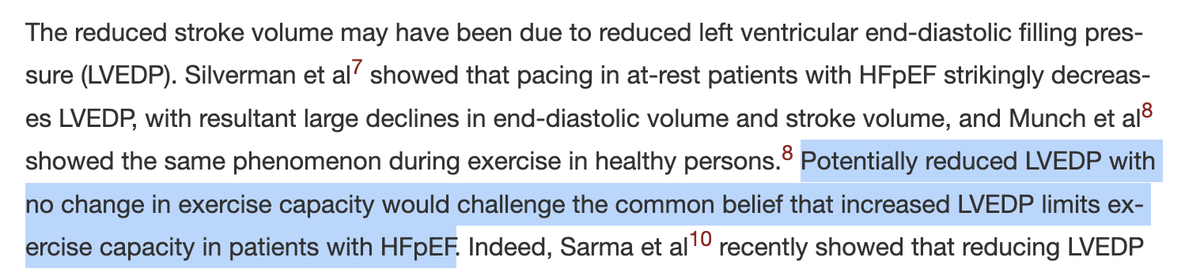
Notes:
Why? Faster HR -> reduced stroke volume due to decreased EDV or preload.
No increase in vo2max OR CO
(this is also true in healthy individuals -> venous return limits .. Here? Probably not venous return itself but the ability of the heart to accept filling)
2 takeaways from this:
Fixing the chronotropic incompetence does not improve the dyspnea… is chronotropic incompetence adapative?
This MAY also reduce wedge (though not necessarily)
little attention has been given to reduced exercise
arteriovenous oxygen difference, which accounts for more
than 50% of the severely reduced peak V˙ O2 in patients with
HFpEF15 and is due primarily to their severe skeletal muscle
dysfunction.

Slide 19
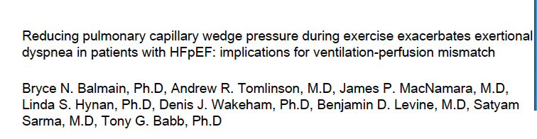
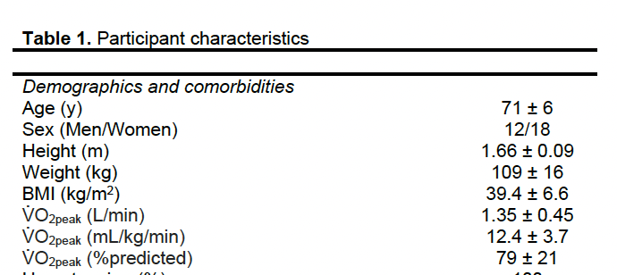
single-blind, randomized (to nitro or placebo) cross-over trial.
Invasive CPET in 30 patients with HFpEF
Upright cycling at 20W (not maximal intensity exercise)

Slide 20
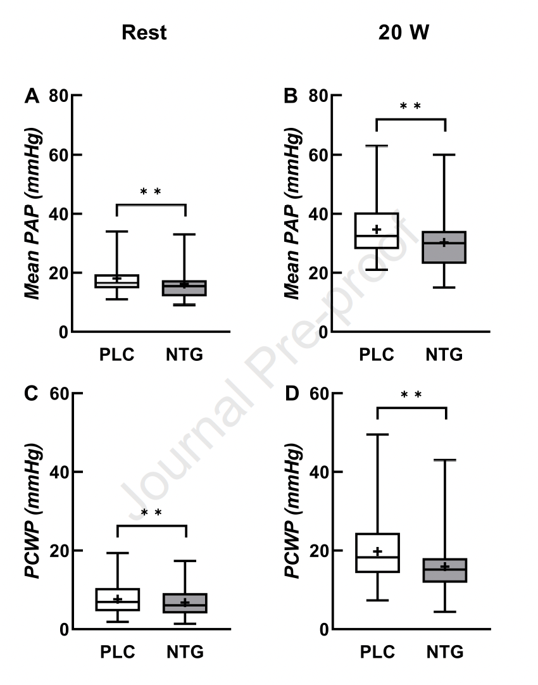
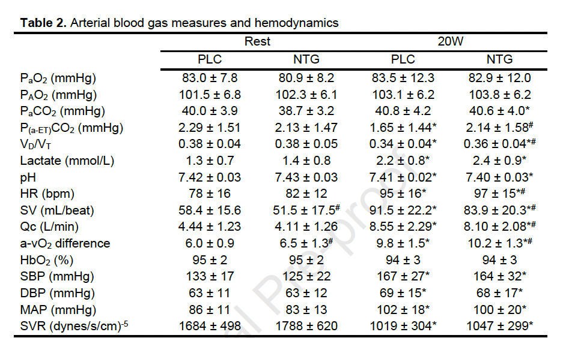
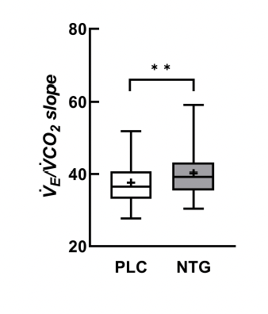
no decrease in PVR from Nitro
Notes:
In sum:
NTG worsens CO with exertion
NTG worsens Vd/vT

Slide 21
“These findings have important clinical implications and indicate that lowering PCWP does not decrease DOE in patients with HFpEF; rather, lowering PCWP exacerbates DOE, increases ventilation-perfusion mismatch, and worsens ventilatory efficiency during exercise in these patients. This study provides compelling evidence that a high PCWP is likely a secondary phenomenon rather than a primary cause of DOE in patients with HFpEF,”
Things that might cause dyspnea in patients with HFpEF:
Poor V/Q matching -> increased ventilation requirement
Poor circulation -> stagnant hypoxemia -> hyperventilation -> increased ventilation requirement
Elevated PCWP -> congestion -> increased respiratory system loads
How long does it take for the interstitial edema to change?
The combination of these two study suggests:
The slow heart rate is probably not often a cause of dyspnea
The high filling pressures are (acutely) required for two purposes:
They allow for maintenance of CO by allowing for adequate preload
They allow for V/Q matching (loss of blood flow to apices?) in the setting of congestion
Notes:
Diastolic dysfunction -> adaptations to allow for filling: higher pressure or slower HR (longer diastole) --- is that true? Slower HR -> filling RATE? Would depend on the shape of cardiac filling…

Slide 22
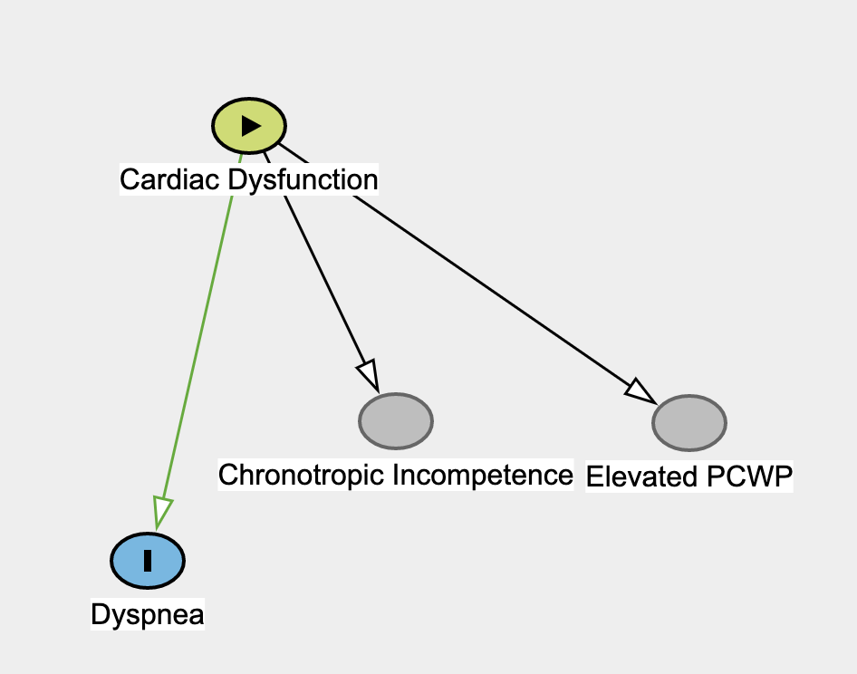
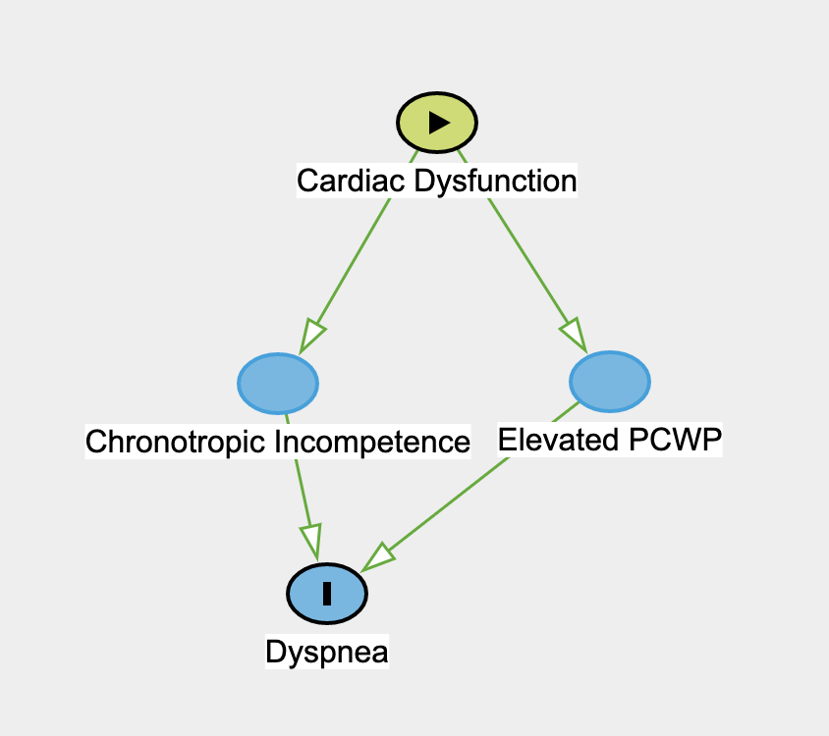
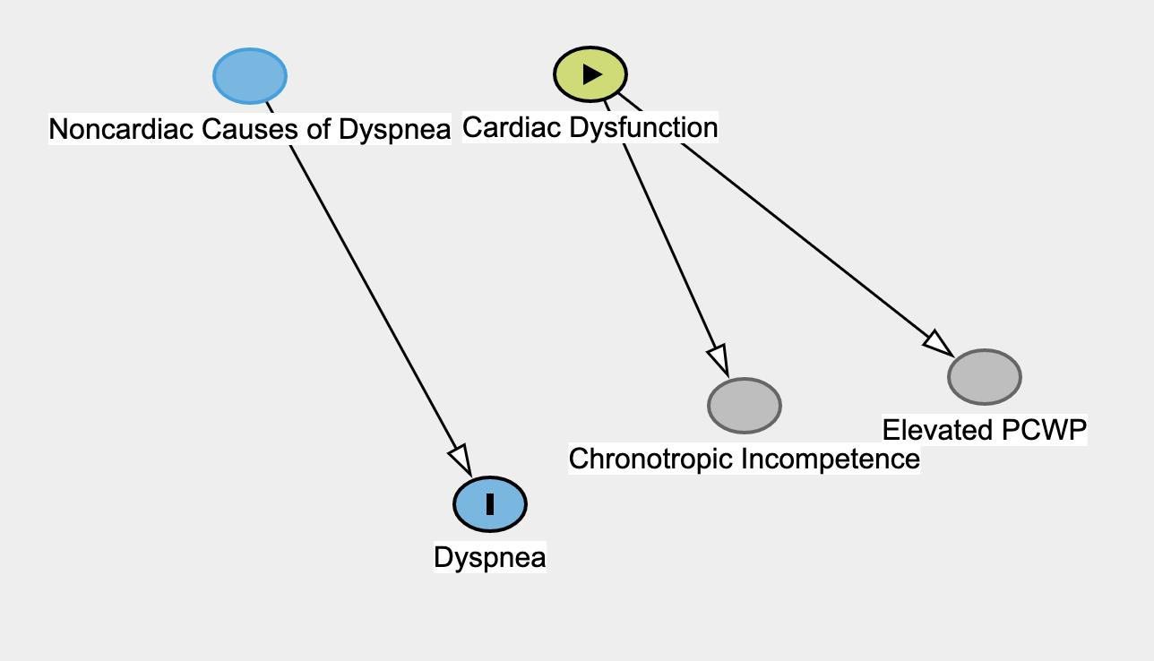
If the elevated PCWP is a epiphenomena or a consequence of whatever causes the dyspnea…
Adaptive?
Traditional Paradigm
How often is HFpEF an incidental finding? (They are congested and SOB, but they are not causally related)
Notes:
DAG
Situation where the patient has an elevated PCWP pressure and dyspnea, but they aren’t related? Obesity and elevated pleural pressure
Dag with
(the problem)-> congestion
(the problem)-> dyspnea
But not, congestion -> dyspnea
Additionally, there are probably people where the correct diagnosis of HFpEF is not even contributing to dyspnea (ie. they have congestion and dyspnea, but the two are not related [ converse of this situation ]

Slide 23
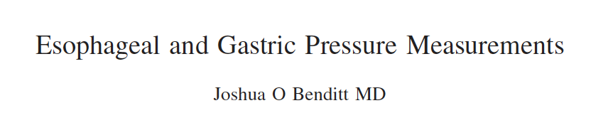
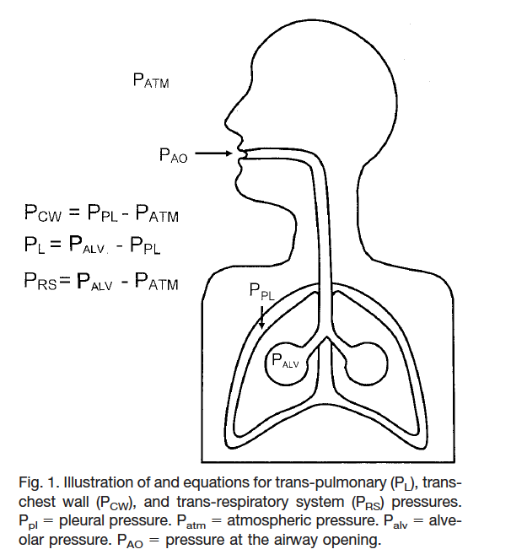
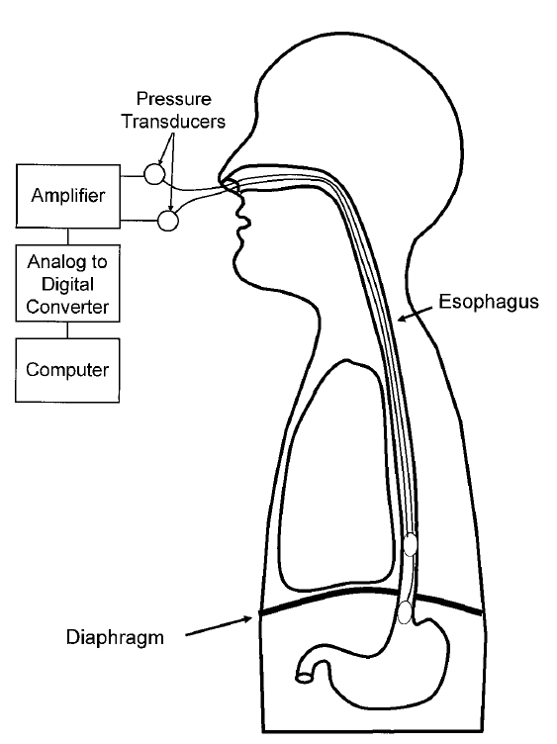
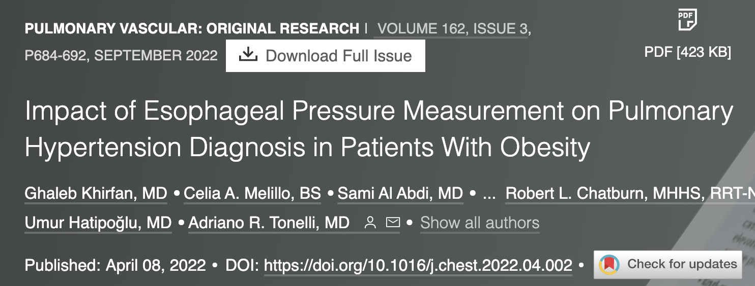
Should RHC measurements be adjusted for intrapleural pressure for HFpEF?
Yes/No/Maybe?
Notably, more than 80% of patients with HFpEF are obese

Slide 24
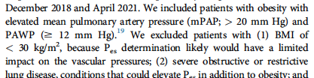
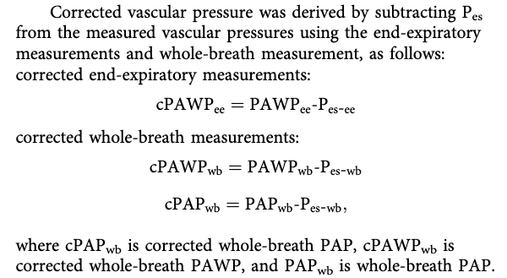
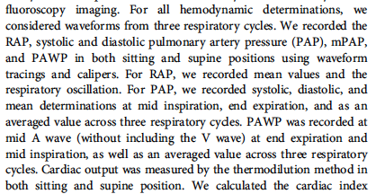
Review: what did the study do?
Notes:
We placed the esophageal balloon catheter in the sitting position, after
anesthetizing the oropharynx with benzocaine 20% spray. In all cases,
we used a 5F catheter (CooperSurgical), either through the right or left
nostril after applying a water-soluble lubricant.
length of the esophageal probe to be inserted by measuring the
distance from the xiphoid process across the tip of the earlobe to the
tip of the nose. Typical range of insertion was 35 to 45 cm
After esophageal balloon insertion, patients were instructed to inhale
briskly, exhale, and then cough. Catheter position was confirmed by
waveform analysis, including sharp respiratory pressure oscillations
(negative deflection with inspiration and positive with exhalation or
cough) and the presence of small cardiac oscillations.We paid particular
attention to the Pes waveform to make sure that it was not dampened
and that we could differentiate clearly between inspiration and
expiration phases. The esophageal catheter was then secured with tape
to the bridge of the patient’s nose and the guidewire was removed. We
simultaneously recorded pulmonary vascular pressures as well as Pes at
end expiration and mid inspiration and the averaged value across three
respiratory cycles, both in sitting and supine positions. Supine and
sitting pulmonary vascular pressures were adjusted for the effect of
intrathoracic pressure by subtracting supine and sitting Pes at the same
respiratory interval. All transducers were leveled and zeroed to
atmospheric pressure at the fourth intercostal space, mid-axillary line,
using an I-beam level. Waveforms were recorded in a hemodynamic
recording software for off-line analysis (iCollect; GE Healthcare).
“Recently, Mojoli et al. have suggested determining the best filling volume using the volume providing the maximum difference between end-inspiratory and end-expiratory P_{es} (i.e., maximizing ΔP_{es})”
“PH. Current PH
guidelines and proceedings recommend measuring
pulmonary vascular pressures at end expiration,8,27 but
other groups have highlighted the importance of
obtaining an averaged value across the respiratory
cycle
“

Slide 25
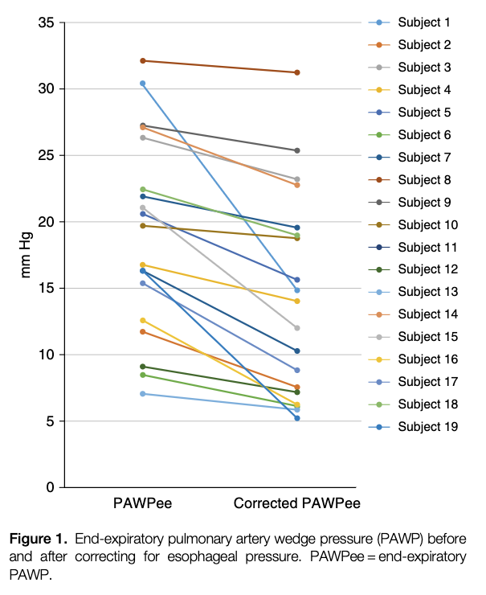
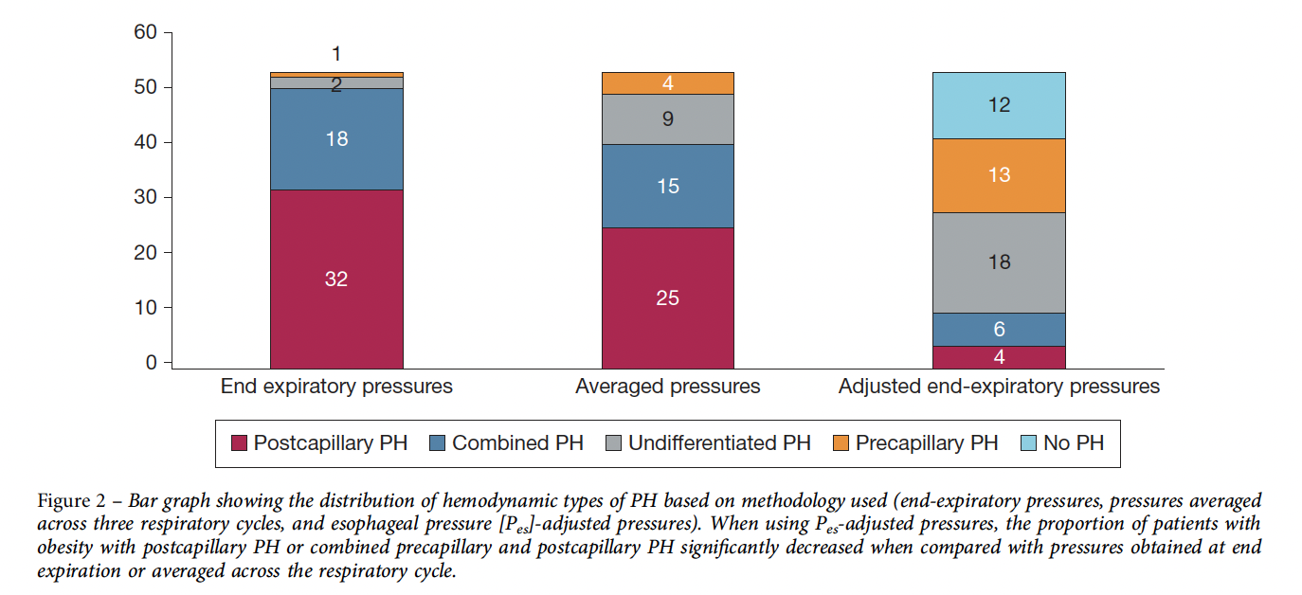
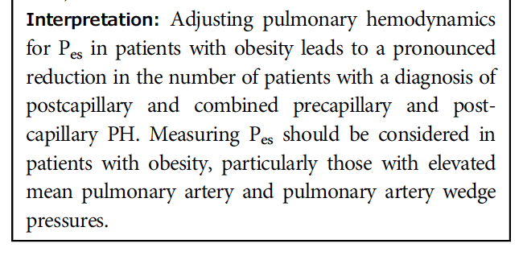
What did they find?
More obese patients would be candidates for vasodilators
More obese patients would not be labeled as having PH.
Many obese patients who previously were post-capillary will be undifferentiated (PVR > 2 but < 3, PA > 20, PCWP < 12.
Notes:
53 patients with a mean SD age of 59
12 years, mean SD BMI of 44.4 10.2 kg/m2 (range,
30.4-93.9 kg/m2)

Slide 26
Lowing afterload (diuretics) aren’t likely to help 1 and 3.
Patient (Q=3 for all) | PA_m | PCWP (ref atm) | P_pl | PCWP_corr | PVR | PAH Class Old | PAH Class New
1 – high pl, low rv afterload Low lv preload | 35 | 20 | 10 | 10 | 5 | Group 2 | Group 1
2 – low pl, high rv afterload, high lv preload | 35 | 20 | 0 | 20 | 5 | Group 2 (CPC) | Group 2
3 - high pl, normal RV afterload, low LV preload | 25 | 20 | 10 | 10 | 1.8 | Group 2 (IPC) | No PH [or, presumably HFpEF]

Slide 27
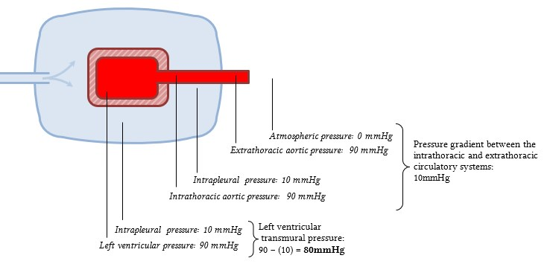
Pulmonary Hypertension: Do we care about transmural or dynamic pressures? Debatable For Heart Failure: We care about transmural pressures (for both preload and afterload)

Slide 28
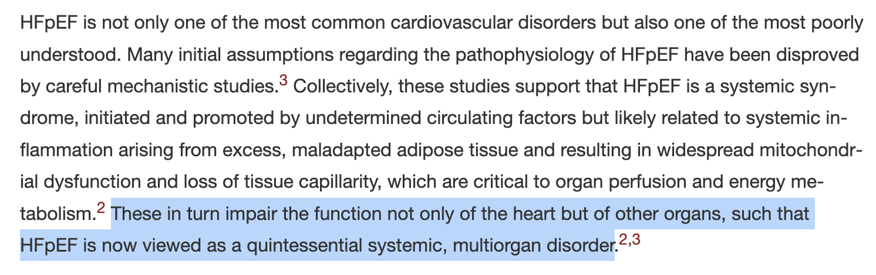
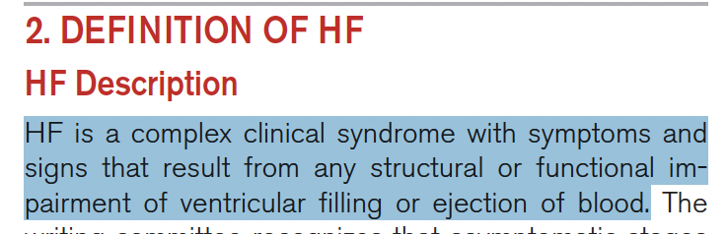
Does ↑PCWP predict pathology or response?
If there is heterogeneity in all of:
The pathology leading to symptoms [surrogate for future treatment/research]
Response to current treatments for that disease
Diuretics will NOT help patients with elevated PCWP due to pleural pressure for e.g.
Prognosis for people with the disease
Then actually “___” is just a bad disease definition
What else are disease definitions supposed to accomplish?
Notes:
Aim: People with the disease share an underlying pathology which predicts treatment response or prognosis (otherwise, what is the instrumental utility?)
Various pathologies (or not) lead to congestion and dyspnea: ESRD, obesity, infiltrative CM, heart block, pericardial disease, etc.

Slide 29
2 new studies
https://x.com/doc_BLocke/status/1681703444074348544?s=20
https://x.com/doc_BLocke/status/1666505807939117060?s=20

Slide 30
Takeaways:
Review diagnostic criteria for HFpEF: elevated filling pressures and dyspnea
Review notable (or not) findings in HFpEF: crackles minimally helpful
What’s up with chronotropic incompetence? Incidental?
What’s up with the wedge? Adaptive? Not causal to dyspnea
What’s up with the pleural pressure? Transmural pressures diverge
Elevated filling pressures and dyspnea is the definition of HFpEF, but it’s not a great definition
Disparate pathologies lead to this (obesity, renal disease, OSA…)
The elevated filling pressures are probably NOT the cause of symptoms, but an epiphenomenon or adaptive mechanism
Symptom/Sign Interpretation: Chronic HF is not a disease of crackles; Diurese then diagnose re: CT abnormalities.

Slide 31
Patient:
CPET:
VO2 max ~45% weight normalized predicted; low AT
VEVCO2 43
Maximum HR 110; Significant metabolic acidosis
VE achieved > (normal) MVV; Low (negative) BR; no obstruction pre or post.
Interpretation:
He has ventilatory limitation due to a high ventilation requirement (inefficient ventilation; probably from HFpEF and emphysema)… but minimal excess respiratory system loads.
He has chronotropic incompetence
I tried taking of the BB (no indication for it) and some evidence withdrawal helps*
Maybe an SGLT2 inhibitor (improves QoL and Exertional Capacity in HFpEF)
He needs to quit smoking and lose weight… but inhalers?
Notes:
Baxter 1006

Slide 32
There are no pharmacologic treatments that improve dyspnea in HFpEF? T/F
True
False

Slide 33
There are no pharmacologic treatments that improve dyspnea in HFpEF? T/F
True
False
Empagliflozin and Dapagliflozin (2 trials; 12,000 patients)➔ reduced HR of re-hospitalization (HR ~0.7) and improved Kansas CM score + 6MW in Dapa case.
similar impact on the rate of HF hospitalizations or cardiovascular death regardless of age, sex, EF, presence of diabetes, body mass index, or kidney function (range allowed in the trials: estimated glomerular filtration rate >20-25 mL/min/1.73 m²)
Also cardiac rehab.
Notes:
Spironolactone no – though there was some concern that data from some of the participating centers/countries was not reliable
Entresto no
likely increase exercise capacity and
qualify of life as well
The success of SGLT-2 inhibitors may
be due to their broad, pleiotropic, metabolic activity that
may uniquely address the systemic, multifactorial, multiorgan
nature of HFpEF.

Slide 34


